Slide 1


Careershift
Platform Tour
Spring 2026

Slide 2
Table of Contents
1
New Careershift Platform Overview
2
The Job Seeker Experience
3
The Admin Experience
Notes:
Scattered Reporting — email, paper, word-of-mouth, no standardized forms, critical details lost
No Follow-Through— patrons/staff never hear back, no accountability creating an environment of distrust.
Is it in email? On a document? Not having Issues/Incidents centralized ensures inaccurate reporting and no ability to track year over year.
Do a percentage of your issues/incidents came from the same reoccurring patrons? How can you identify repeat patterns without annecdotes

Slide 3
Overview
Find, apply, succeed.
New look, less clicks.
Real Market Intel.
Careershift got a full refresh: simpler to navigate, smarter by design.
A modernized interface and streamlined navigation.
Live salary benchmarks, hiring trends, and employer data built right in.

Slide 4
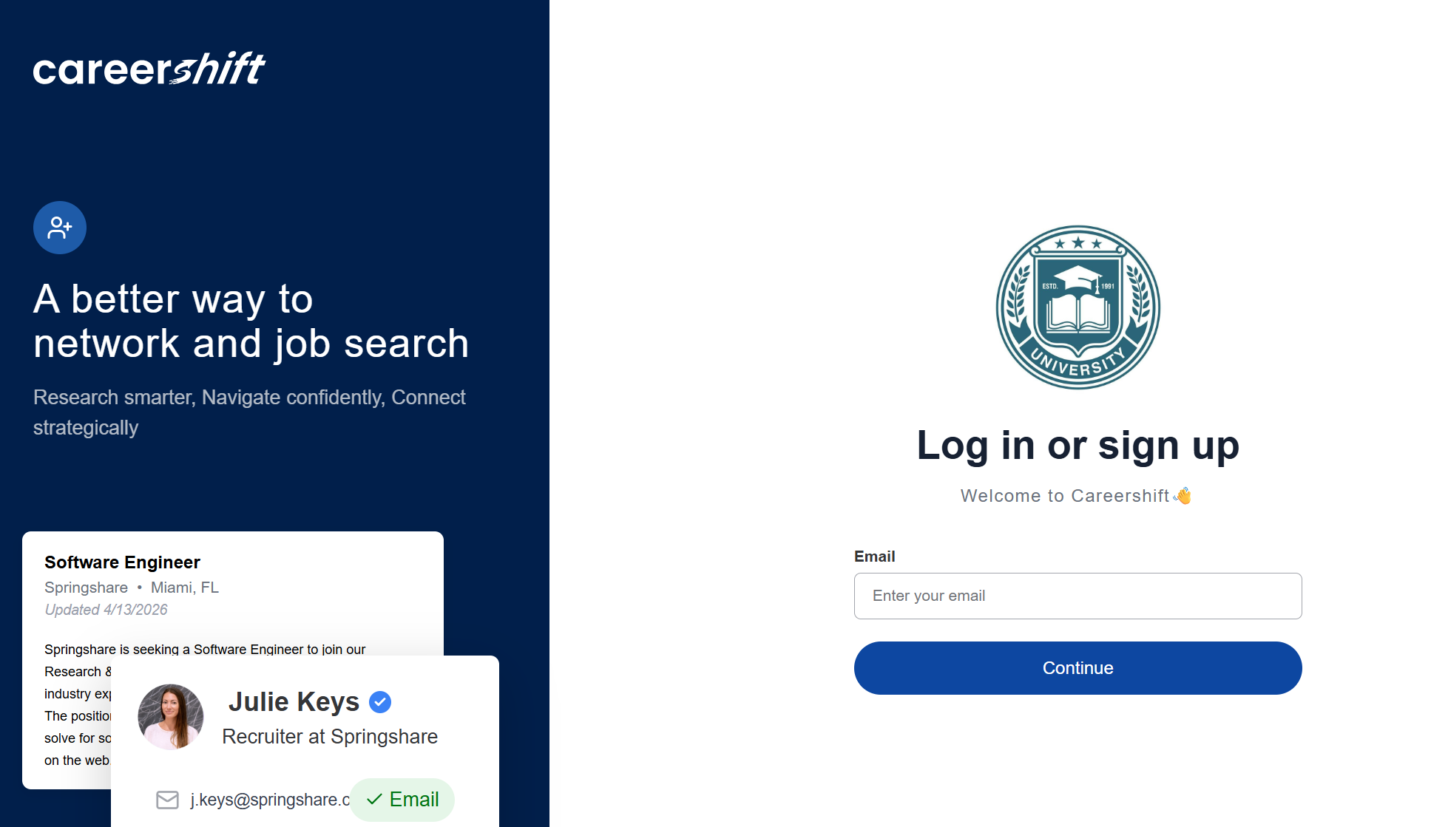
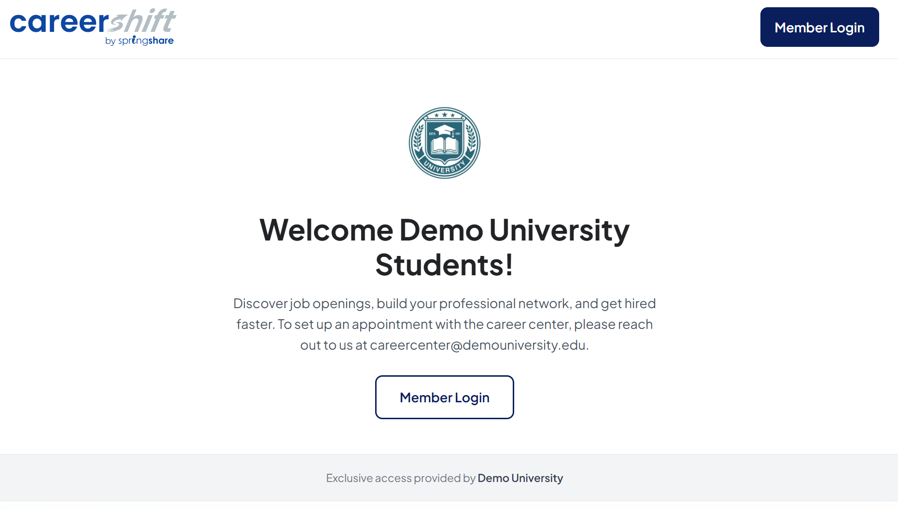
Job Seeker Experience
Landing page and Registration

Slide 5
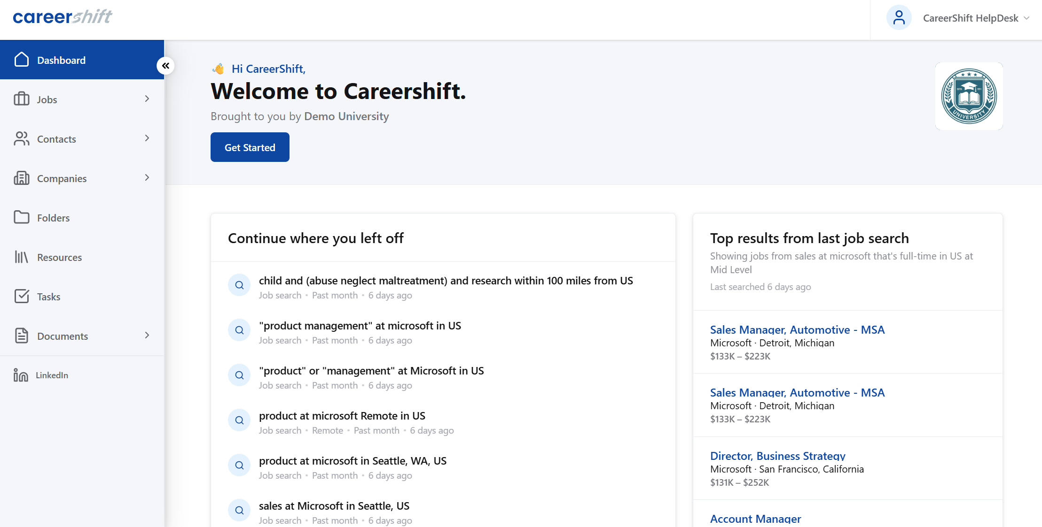
Job Seeker Experience
The Dashboard: clean, intuitive, and built around calls to action

Slide 6
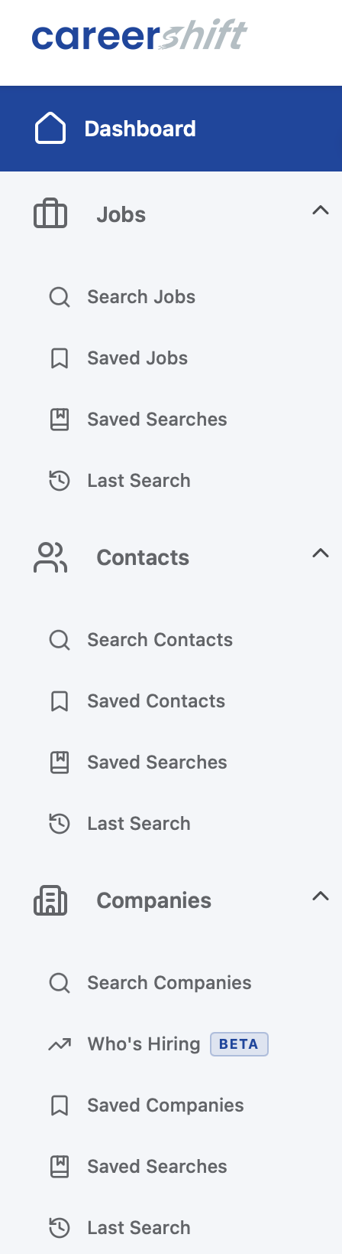
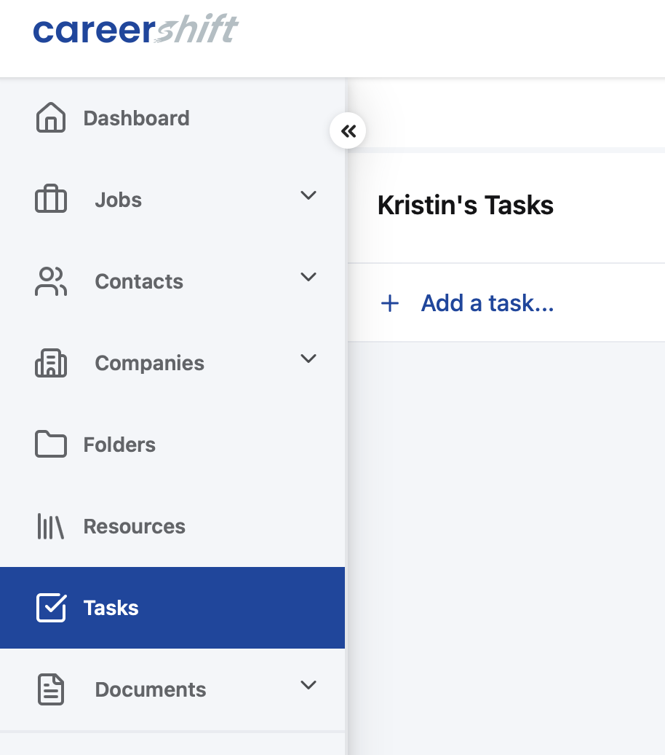
Job Seeker Experience
Navigation
Single, left-side navigation menu bar
Same job, contact, and company search features
Same saved searches capability to jump in where
you left off
New Tasks feature

Slide 7
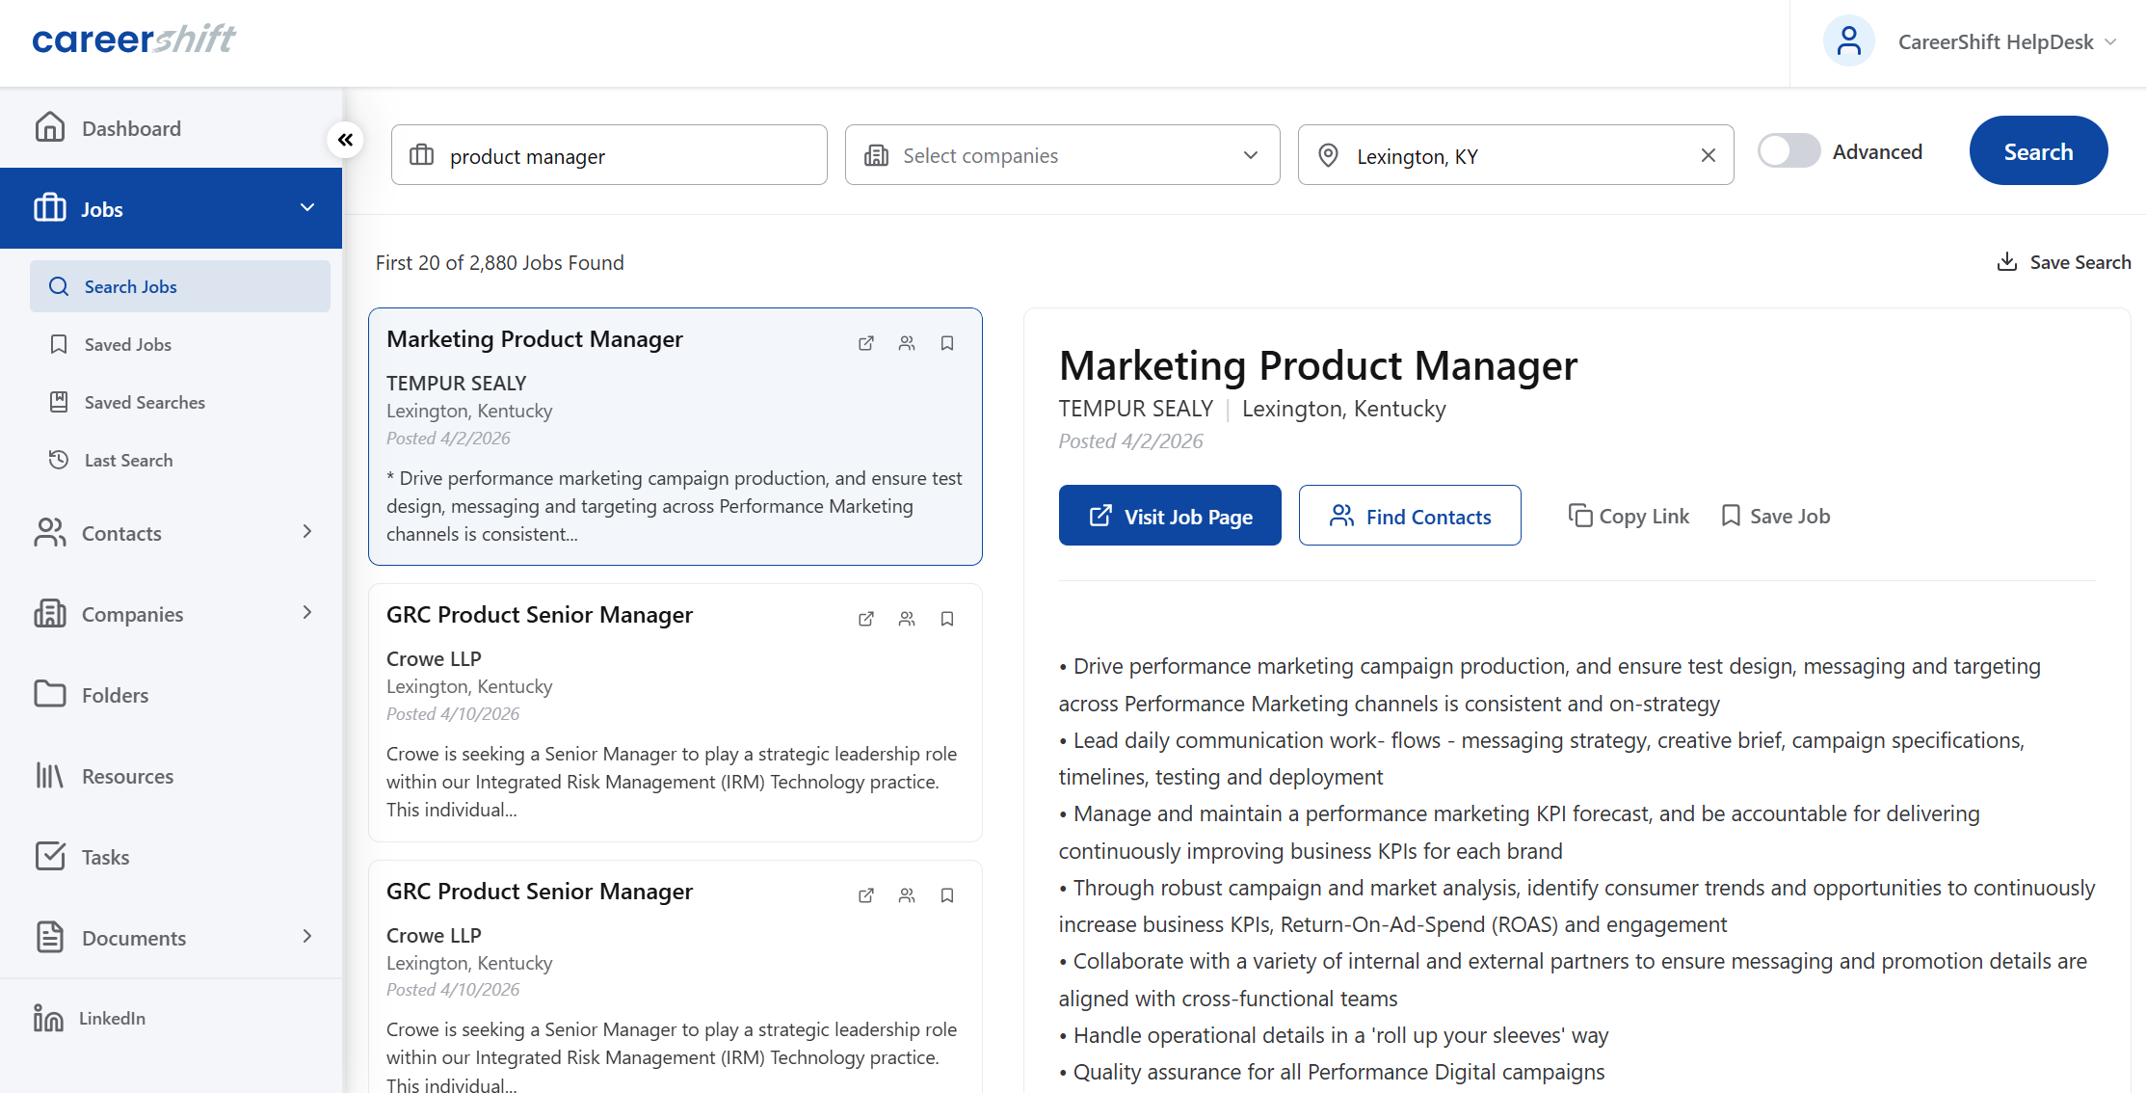
Job Seeker Experience
Job Search: Job listings database refreshed every 24 hours from millions of original company sources as well as aggregate job sites from 15 countries

Slide 8
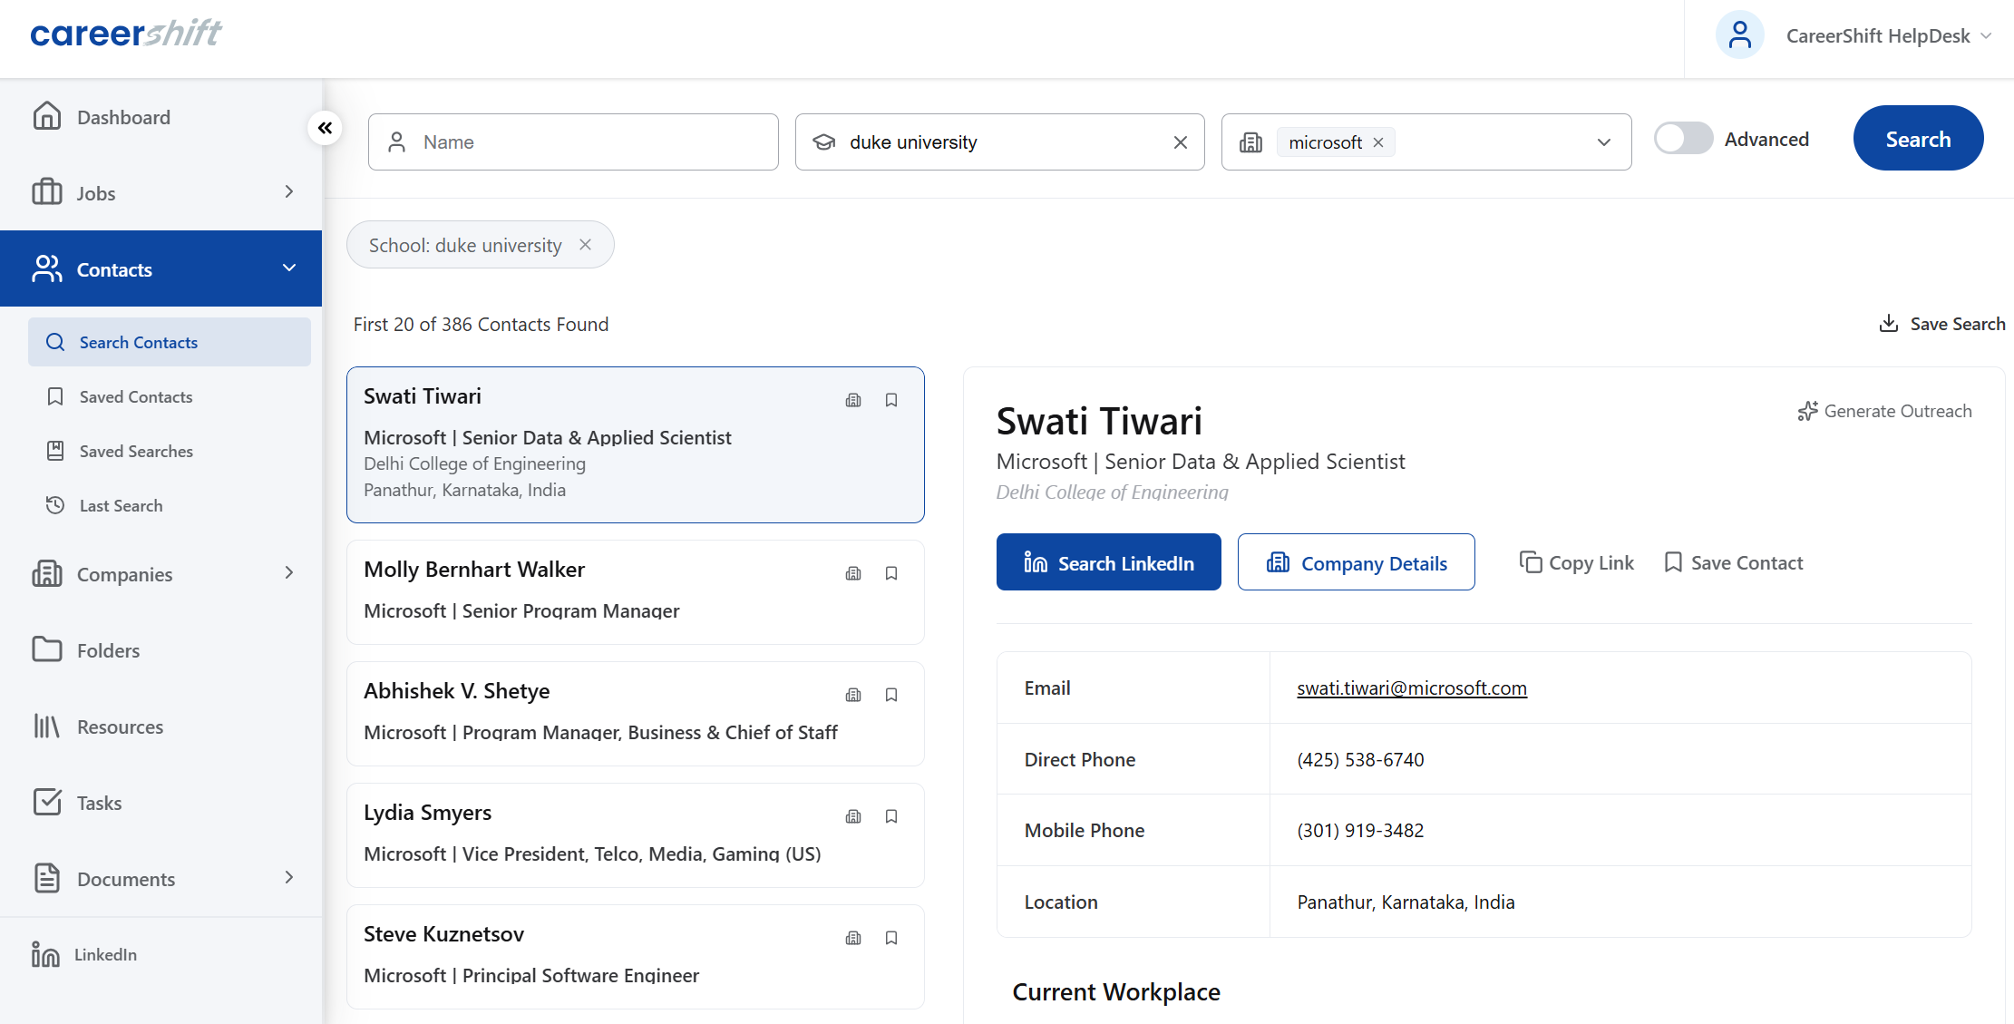
Job Seeker Experience
Contact Search: Global contact database of more than 600M professional profiles, 300M with direct emails, representing professionals at all organizational levels

Slide 9
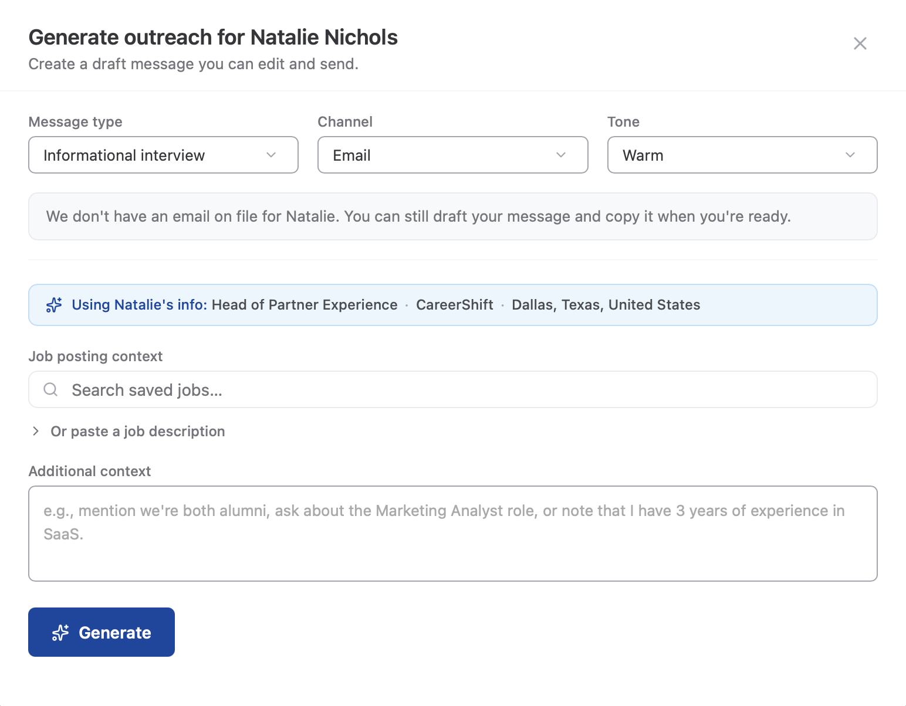
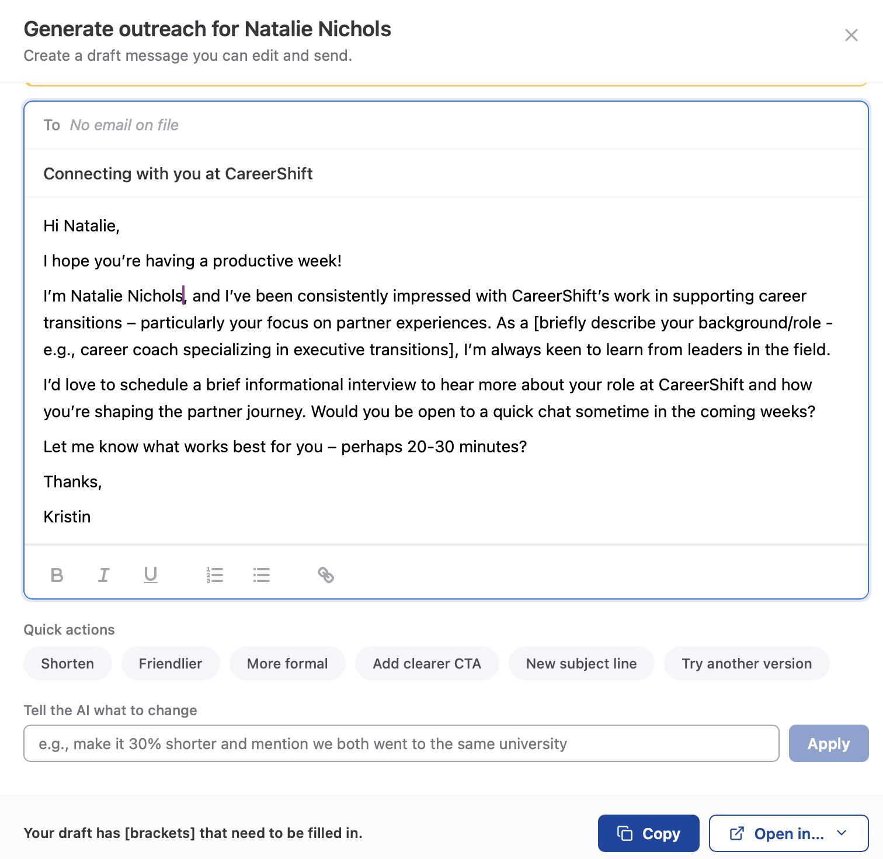
Job Seeker Experience
Generate Outreach: Help compose targeted outreach based on the contact’s profile, a job description, and additional context provided by the user

Slide 10
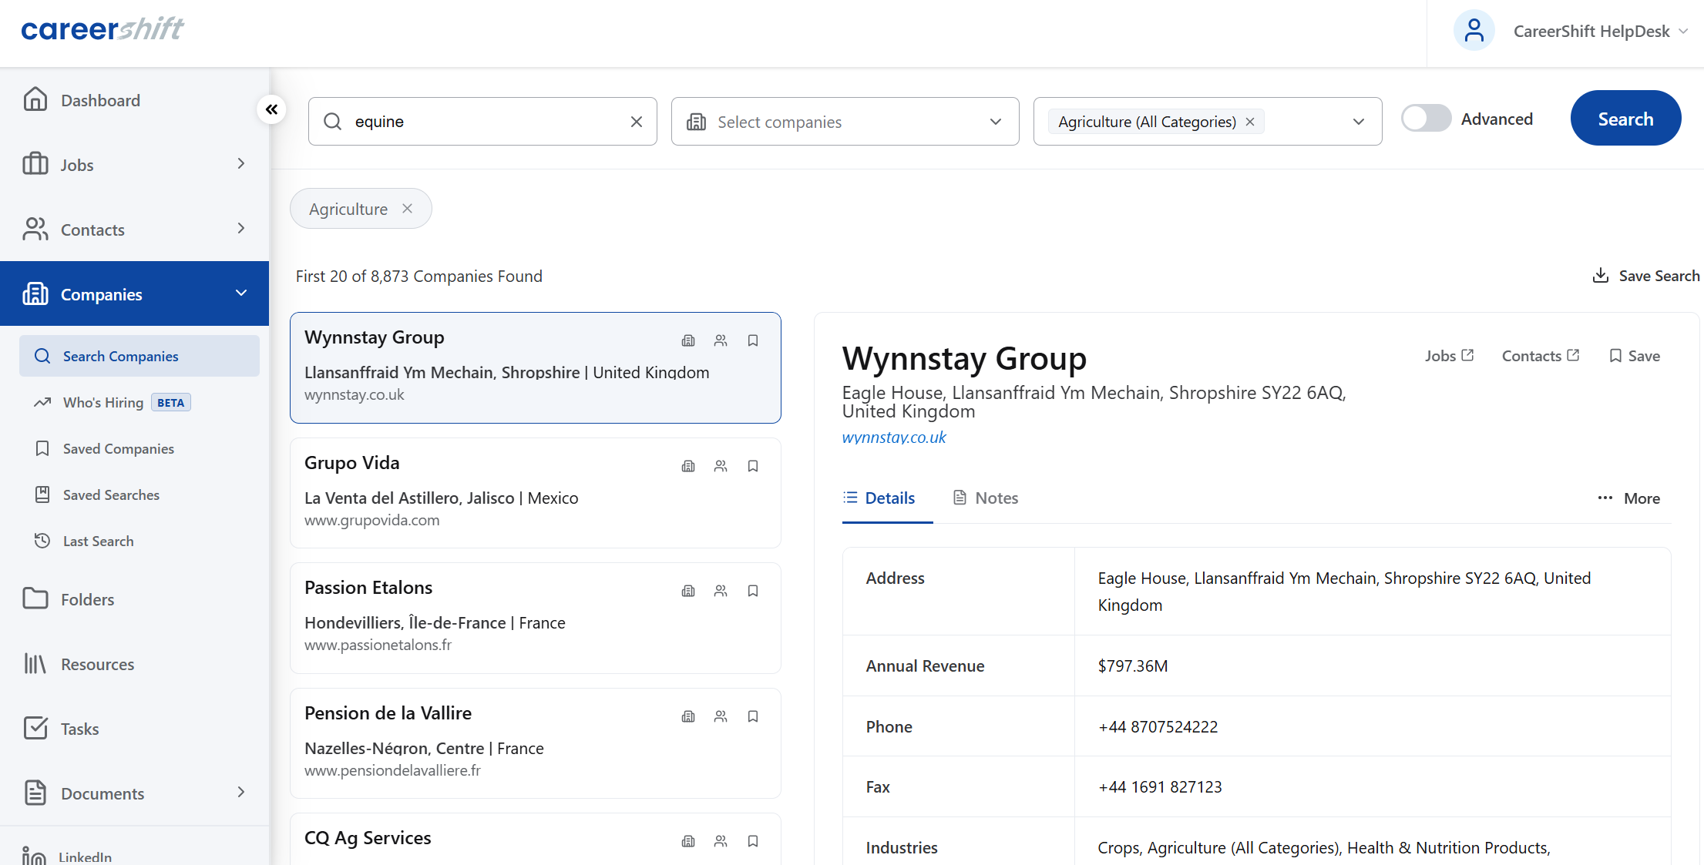
Job Seeker Experience
Company Search: Global company database of more than 100M organizations continuously enriched with data collected via both automated and human research processes

Slide 11
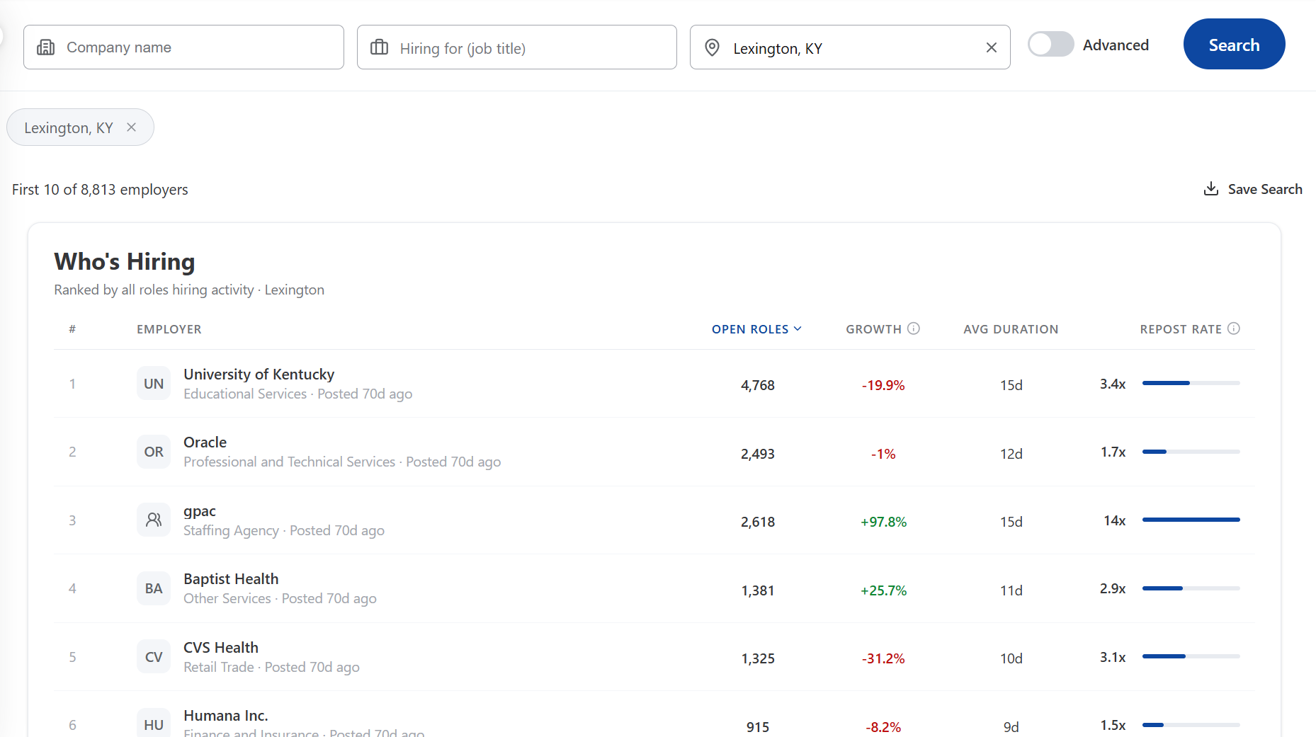
Job Seeker Experience
Company Search: Who’s Hiring? New filter that pulls in real signals to indicate hiring growth, helping job seekers move past brand-name bias and target and target companies experiencing real growth

Slide 12
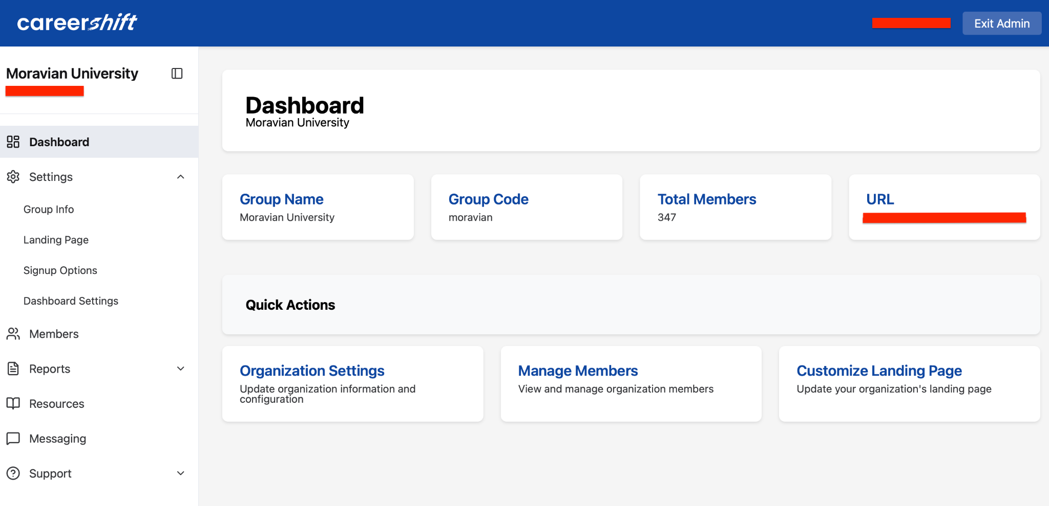
Admin Experience
The Dashboard: Access all parts of the app from one place, Exit Admin in the top right to switch to a user experience

Slide 13
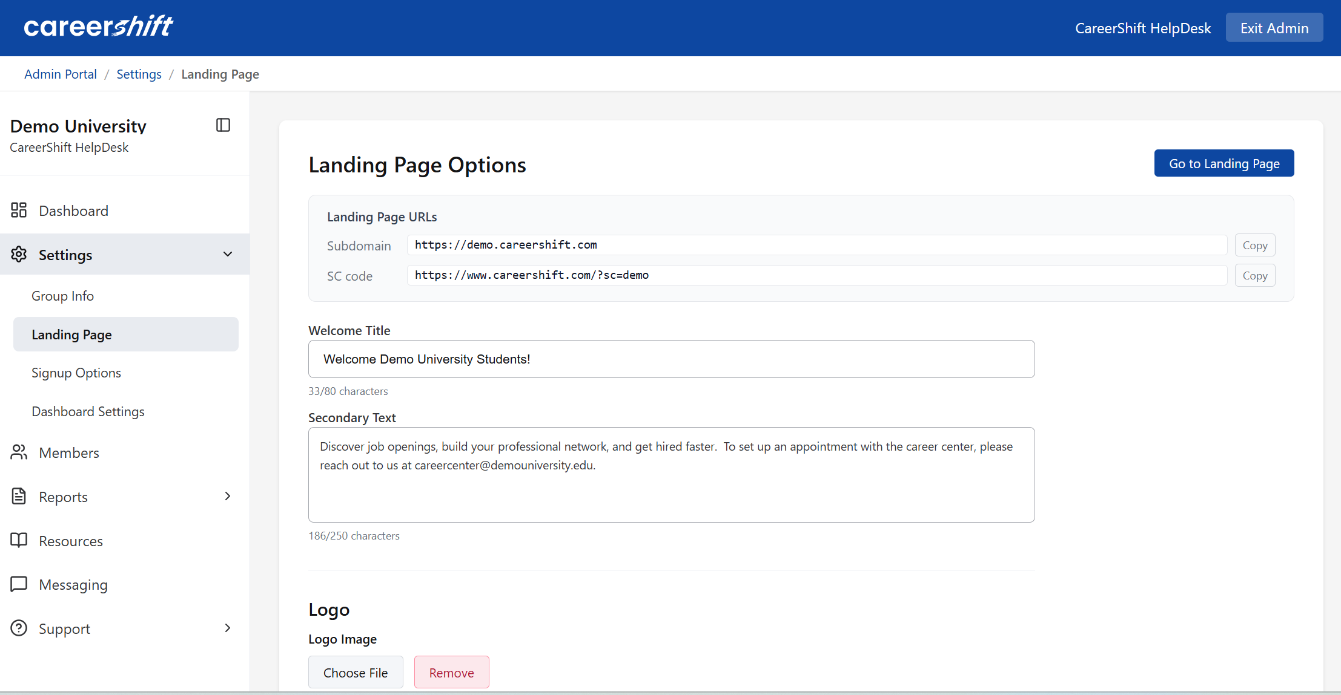
Admin Experience
Settings: Manage your landing page content and review how you provide access to your users

Slide 14
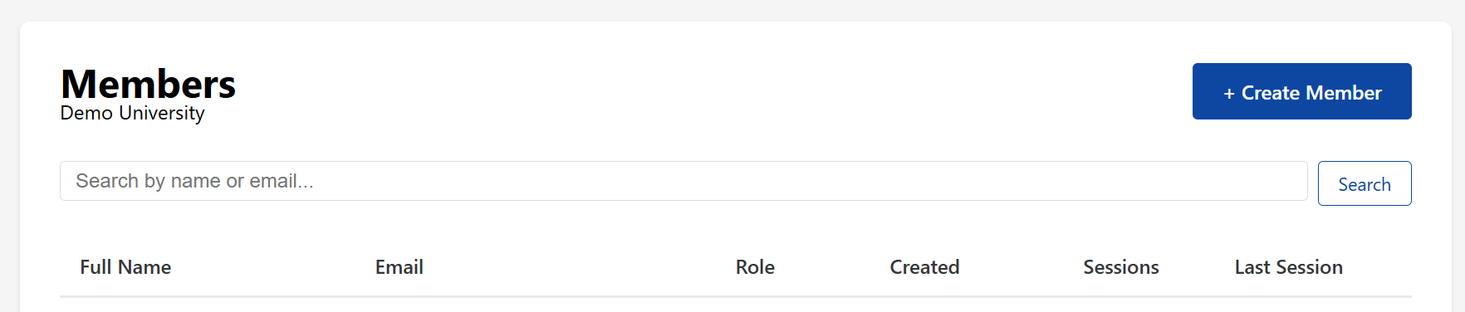
Admin Experience
Members: Add new members, assign roles and access, and view user activity

Slide 15
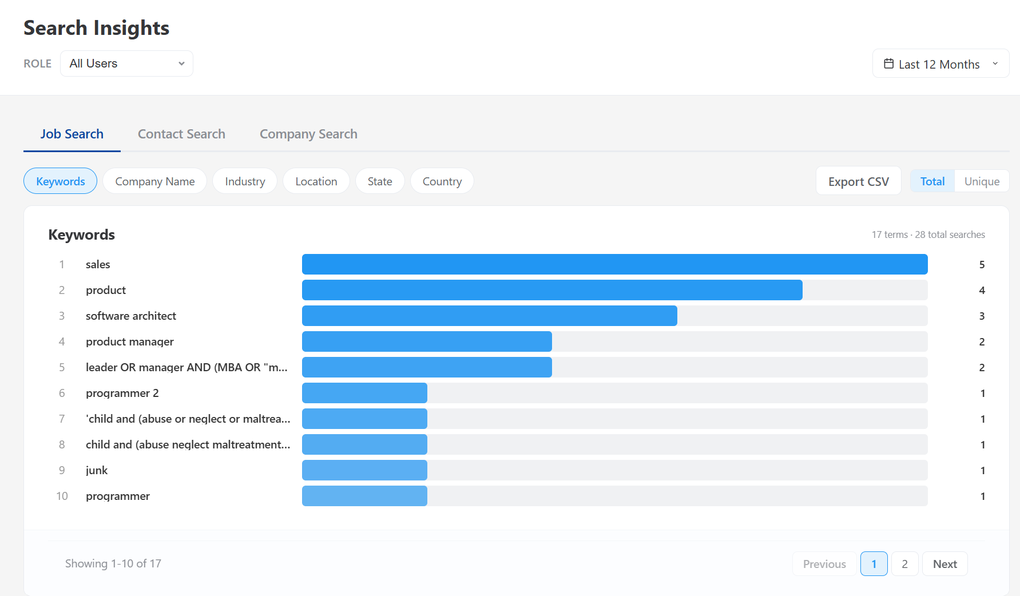
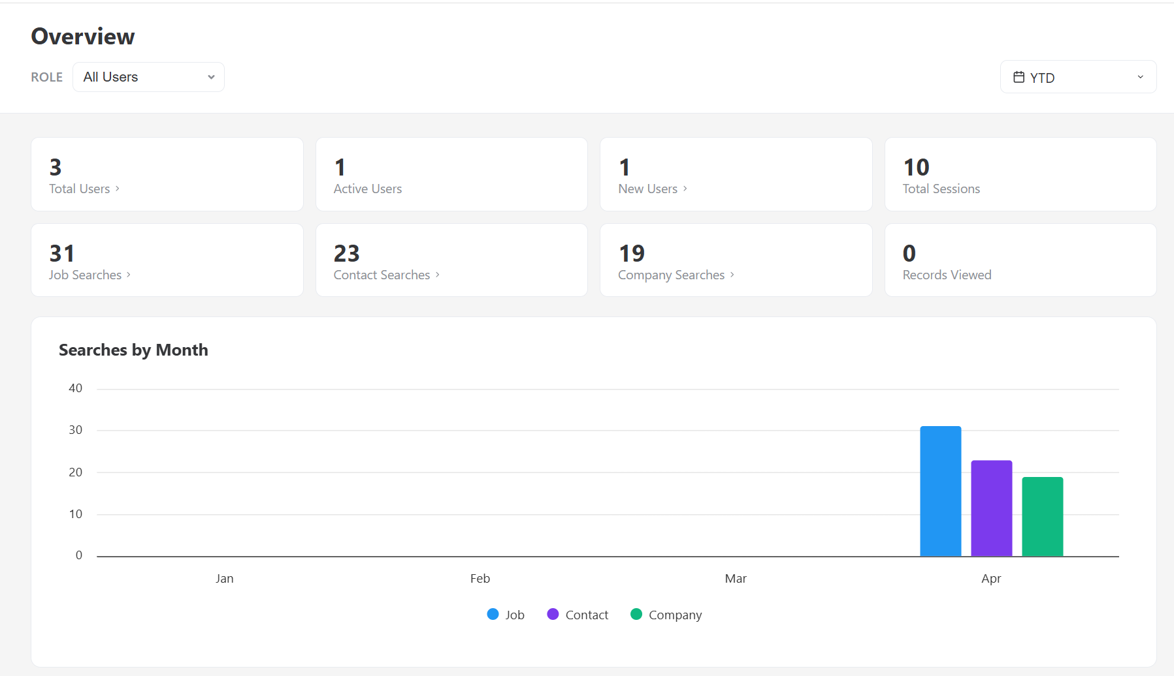
Admin Experience
Reporting: Get an overview, dive deeper by user, or by keyword search and export at the touch of a button
museum internship
marketing analyst
teacher

Slide 16
Thank you!
Reach out to support@careershift.com with questions!

Slide 18
Closing the Loop & Building Trust
Too often, patrons and staff report an issue and never hear back.
Built-in communication tools close that gap.
Reply
Update
Transparency
Morale
Built-in email and SMS replying directly within the platform
Timely status updates tied to the issue record
When reports lead to action, trust in leadership grows
Staff see real progress, replacing vague handling with accountability
Notes:
Feedback Loop — built-in email/SMS replies, timely updates, comms tied to issue records.
Staff Empowerment — staff see real progress, transparency replaces vague handling, trust in leadership grows.

Slide 19
Actionable Insights & Patterns
1
Surface recurring problems — facilities, policy violations, patron history
2
Address root causes before small issues become big ones
3
Patron database via ILS integration gives staff full context without platform switching
4
Data-driven reporting makes analysis and decision-making dramatically easier
Notes:
Identify Patterns — surfaces recurring problems, spots policy violations, enables proactive solutions.
ILS Patron Integration — patron database via ILS, full context without platform-switching, nothing falls through cracks.

Slide 20
Connected Ecosystem:
Deep LibApps Integration
LibCal
LibMaps
LibAnswers
Ban patron bookings & reservations directly from an incident record
Drop a pin to show exactly where an incident occurred in your facility
Report harassing behavior directly from LibChat conversations
Notes:
Connected Ecosystem — integrates with LibCal, LibMaps, LibAnswers; drop pins for incidents; report via LibChat.
Automated Actions — ban bookings/reservations via LibCal, streamlined cross-platform workflows.

Slide 21
Live
Demo
Time
Let’s see it in action!

Slide 22
Career Support is Core to the Future of Libraries
How Public Libraries Are Redefining Workforce Development

Slide 23
What We'll Cover Today
01
The Evolving Role of the Public Library
02
Why Career Support Is Now a Core Service
03
What Patrons Really Need
04
Tools & Resources: CareerShift for Libraries
05
Real-World Impact & Success Stories
06
How to Implement Career Services

Slide 24
Libraries Are Already in the Career Business
WHAT LIBRARIES HAVE ALWAYS DONE
WHAT THAT MEANS FOR CAREERS
Provide free access to information
Connect community members to resources
Offer trusted, neutral guidance
Serve everyone — regardless of background
Reduce barriers to opportunity
Job search databases & labor market data
Resume & cover letter workshops
Digital literacy and computer access
Safe space for vulnerable job seekers
Bridge to workforce programs & employers

Slide 25
Career Support is a
Library Value
"Embracing career support isn't a pivot away from the library's mission — it IS the mission. Libraries exist to empower people with information and opportunity. For millions of Americans, a job is the most important thing they'll ever search for."
— SpringShare Blog, February 2026

Slide 26
What Job-Seeking Patrons Actually Need
Job Search Tools
Networking Support
Company Research
Access to curated, trustworthy job listings beyond public boards
Finding the right people inside target organizations
Intelligence on employers, culture, and contacts

Slide 27
What Job-Seeking Patrons Actually Need
Job Search Tools
Networking Support
Company Research
Access to curated, trustworthy job listings beyond public boards
Finding the right people inside target organizations
Intelligence on employers, culture, and contacts

Slide 28
What Job-Seeking Patrons Actually Need
Job Search Tools
Networking Support
Company Research
Access to curated, trustworthy job listings beyond public boards
Finding the right people inside target organizations
Intelligence on employers, culture, and contacts

Slide 29
CareerShift:
Built for Libraries, Built for Job Seekers
A comprehensive career exploration and job search platform — licensed for library patrons.
🔍
🏢
👤
Contact Finder
Centralized Job Search
Company Research
Aggregates millions of listings from employer websites, not just job boards
In-depth profiles on 2M+ companies including size, location, and contacts
Identify key contacts inside target companies to tap the hidden job market
📄
📍
📚
Resume Tools
Local Opportunities
Library Branding
Build, store, and tailor resumes to specific job postings
Geo-targeted search helps patrons find real local jobs
Co-branded experience that reinforces your library's value

Slide 30
Unlocking the Hidden Job Market
Up to 80% of jobs are never publicly posted. They're filled through referrals, networking, and direct outreach. CareerShift gives library patrons — who often lack professional networks — access to the same intelligence that connected insiders use.
Search for contacts at specific companies by name, title, or department
Find email formats and direct connections at target employers
Go beyond Indeed and LinkedIn to reach decision-makers directly
Level the playing field for first-generation job seekers and career changers

Slide 31
What Real Users Say
“
I had been using standard free job sites for about two months before I heard about CareerShift from a friend. As soon as I started using CareerShift, things changed. Within a week I was interviewing and within a month I landed my job. I truly believe that without CareerShift I would still be wasting my time, and would have missed out on my dream job.
— Mike Kovacic, Network Administrator
“
CareerShift changed everything by providing direct contact information for professionals across a wide range of industries. I was able to connect directly with hiring managers, alumni, and employees at my target firms, which led to meaningful conversations and interview opportunities I would not have secured otherwise.
— Thomas George, Recent Graduate, Fairleigh Dickinson University
“
I particularly love the company contact feature! CareerShift makes that process simple and takes seconds. My first lookup yielded exactly the person I needed for a job application I sent yesterday, as I couldn't find him on all of the usual websites. My search is organized and I feel like I have total control.
— Pete Morano, BA, MBA — Career Transitioner

Slide 32
How to Get Started:
A Practical Path
1
2
3
Assess patron needs
Build staff capacity
Choose the right tools
Survey or observe what job-seeking services patrons are already asking for
Train reference staff to confidently guide patrons through career tools
License platforms like CareerShift that are purpose-built for libraries
4
5
6
Integrate into programs
Market your services
Measure & advocate
Weave career resources into existing workshops, ESL, and outreach
Tell your community: your library is a career center — not a secret
Track usage, collect stories, and report impact to administration & funders

Slide 33
The Future-Ready Library Includes Career Support
According to Springshare's 2026 research, libraries that embrace workforce development and career services are seeing stronger community relevance, higher patronage, and greater funding support. Career services aren't a 'nice to have' — they're a survival strategy.
Career support positions the library as essential to economic mobility
Libraries democratize access to professional-grade tools for everyone
Career programs open doors to workforce boards, employers & grants
Measurable patron outcomes tell a powerful story to decision-makers
Relevance
Equity
Partnerships
Advocacy

Slide 34
Your Library Can Be a
Career Launchpad
1
Career support is not a departure from the library mission — it deepens it
2
Job seekers need more than internet access — they need tools, guidance, and connections
3
Platforms like CareerShift put professional-grade resources in every patron's hands
4
Libraries that invest in workforce services build community trust and lasting relevance
5
The time to act is now — your patrons are already asking
Learn more at careershift.com/Solutions/Libraries

Slide 35
Careershift Analytics (Coming Soon)
Careershift Analytics is an optional add-on module that builds on the Careershift Research platform. It provides aggregated job market data and trend analysis to help Libraries and Job Seekers to better understand demand, emerging career pathways, and workforce patterns over time.
Analytics adds strategic insight to the foundational tools provided by Careershift Research – supporting planning, assessment, and data-informed decision-making.

Slide 36
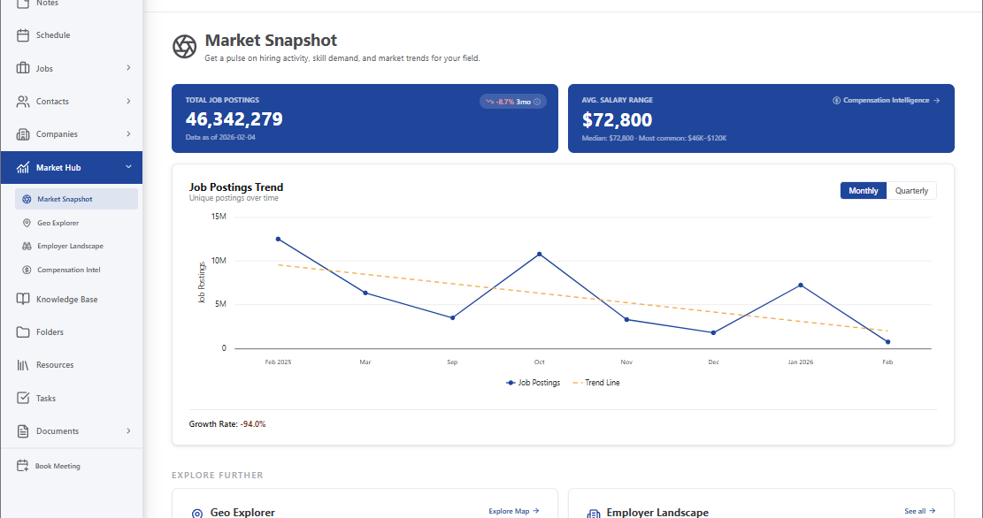

Slide 37
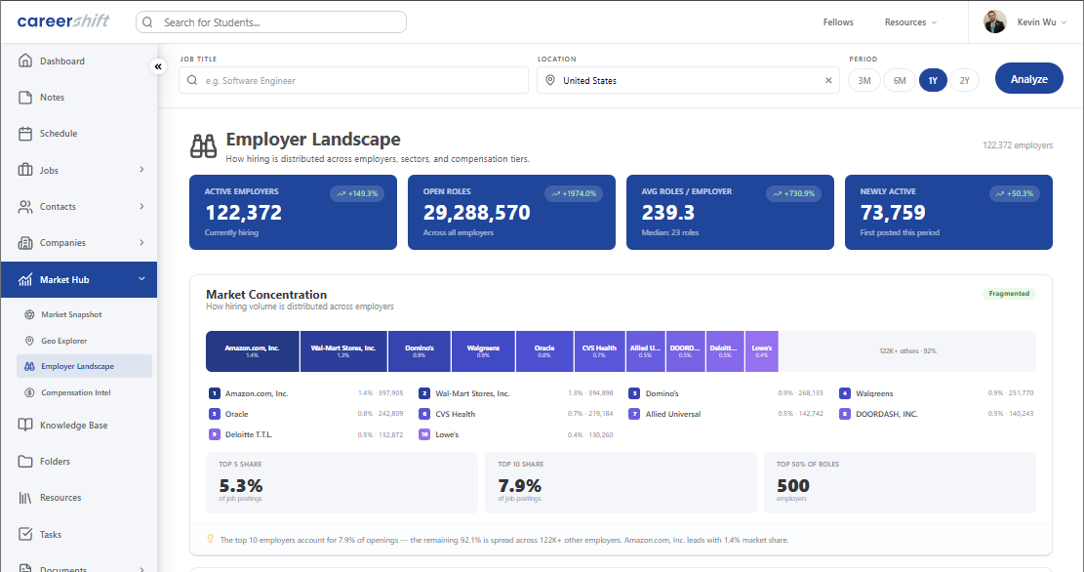

Slide 38
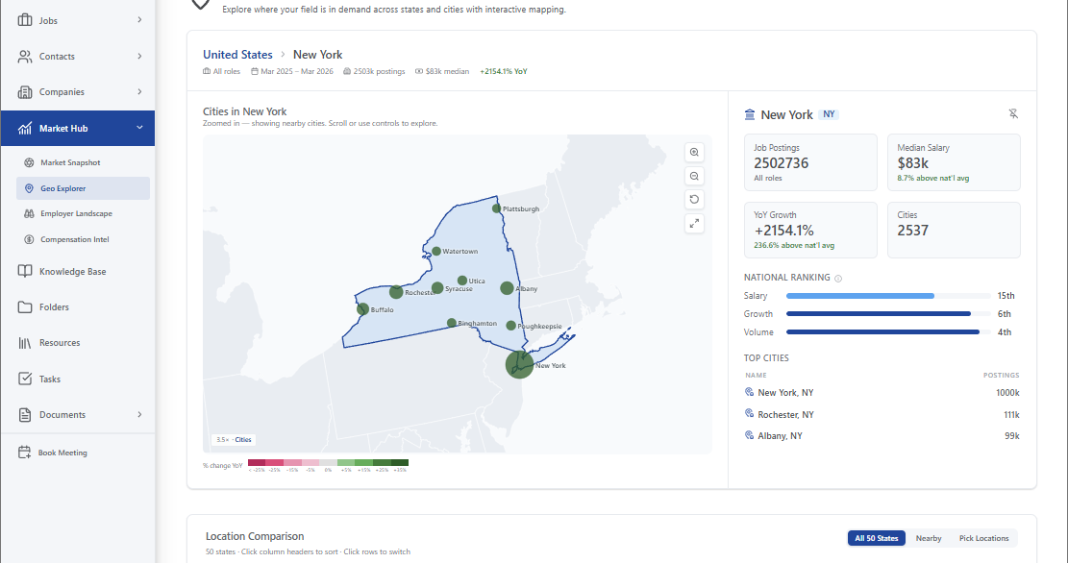

Slide 39
